Slide 1
Framing an Issue from the Sociological Perspective
Same Sex Marriage
Student Name
Institution Affiliation

Slide 2
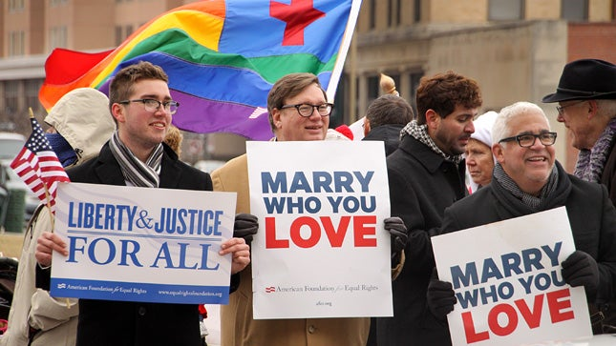
Introduction
Same sex marriage is defined as marriage between same sex individuals.
Gay marriage is the common form of same sex marriage.
2019 polls indicate that 73% Americans support same sex marriage while 0nly 26% oppose it.
Same sex marriage is still illegal in some countries (Gerstmann, 2017).
Notes:
Marriage between two people of the same sex is what is referred to as same sex marriage. Gay marriage (marriage between two males) is the most common type of same sex marriage although there are still lesbian marriages. More than 70% of Americans currently support same sex marriage hence depicting that it will once gain total support. Although in some countries same sex marriage is still illegal., America has over 100,000 legally same sex marriages (Gerstmann, 2017).

Slide 3
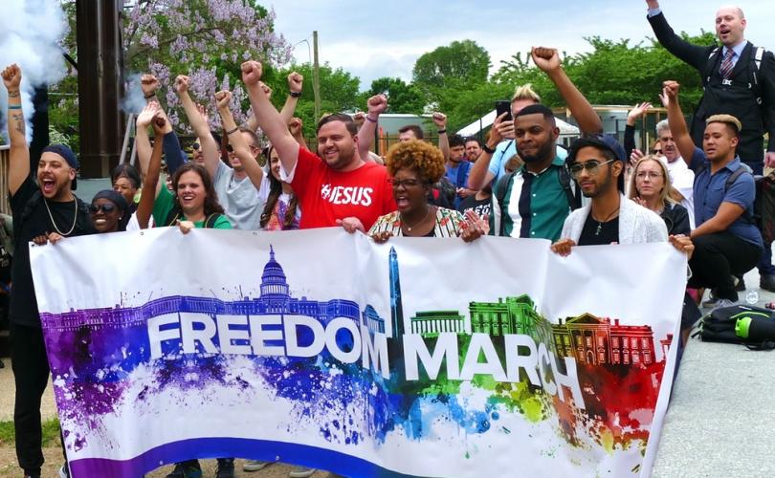
Lesbian, gay, bisexual, transgender (LGBT) Movement
LGBT movement usually stand out for the rights of all Lesbians, gays, bisexual, transgender humans as well as standing for same-sex marriages.
The movement objective is acceptance and equality for the LGBT community.
LGBT movements support their legalized rights.
LGBT movements started in early 19th Century (Poggione, 2019).
Notes:
Every group has its own rights that needs to be respected. LGBT movements started to be formed in the early 19th Century to help protect the violation of the rights of the LGBT populations. Although the LGBT rights were legalized long time ago, most people try to violate the rights of these minorities hence the impotence of these movements (Poggione, 2019).

Slide 4
History of LGBT Rights Timeline
1924- The first documented gay rights organization was founded in Chicago by Henry Gerber “The Society for Human Rights”
1950 - The Mattachine Society was founded by activist Harry Hay. This is one of the first sustained gay rights groups in the U.S.. They focus on social acceptance and other types of support for homosexuals.
April 1952 - The American Psychiatric Association's diagnostic manual lists homosexuality as a sociopathic personality disturbance.
April 27, 1953 - President Dwight D. Eisenhower signs an executive order that bans homosexuals from working for the federal government, saying they are a security risk.
June 28, 1969 - Police raid the Stonewall Inn in New York City. Protests and demonstrations begin, and it later becomes known as the impetus for the gay civil rights movement in the United States (Poggione, 2019).
Notes:
Since the founding of the first document of gay rights organization in 1924, various changes have been noticed over the years. Many more movements have been created with various responsibilities (Poggione, 2019).

Slide 5
History of LGBT Rights Timeline Cont’d
In 1969 - The oldest continuing LGBT publication that began as a newsletter published by the activist group Personal Rights in Defense and Education (PRIDE) the "Los Angeles Advocate," founded in 1967, is renamed "The Advocate.
On June 28, 1970 - Community members in New York City marched through the local streets to recognize the one-year anniversary of the Stonewall riots. The event was named Christopher Street Liberation Day. The event is now considered the first gay pride parade.
On December 15, 1973 - By a vote of 5,854 to 3,810, the American Psychiatric Association removes homosexuality from its list of mental disorders in the DSM-II Diagnostic and Statistical Manual of Mental Disorders (CNN Website LBGT Rights Milestones Fast Facts, 2019).
Notes:
Over the years, different publications have been made about the LGBT community hence making these populations to be much respected (CNN Website LBGT Rights Milestones Fast Facts, 2019).

Slide 6
History of LGBT Rights Timeline Cont’d
October 14, 1979 - The first National March on Washington for Lesbian and Gay Rights took place. The March drew an estimated 75,000 to 125,000 individuals marching for LGBT rights.
March 2, 1982 - Wisconsin becomes the first state to outlaw discrimination based on sexual orientation
May 9, 2012 - In an ABC interview, Obama becomes the first sitting US president to publicly support the freedom for LGBT couples to marry (CNN Website LBGT Rights Milestones Fast Facts, 2019).
Notes:
Many more people have continued to support LGBT couples to marry including the president (CNN Website LBGT Rights Milestones Fast Facts, 2019).

Slide 7
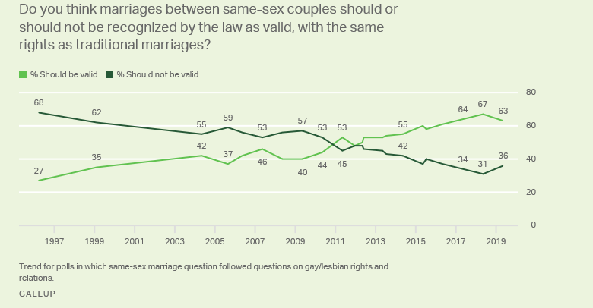
Public Support for same sex marriage grows
Notes:
Same sex marriage has gained more and more support from the public. As at 2019, approximately 73% of the US population was supporting legalization of Same sex marriage. The support of same sex marriage has grown over the years and is expected to grow further.

Slide 8
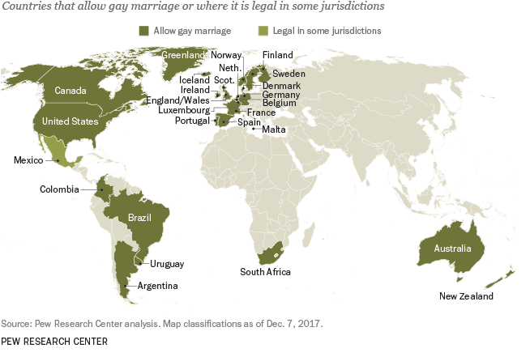
Sample of Gay Marriages around the world
Notes:
Research depicts that there are approximately 26 countries in support of Gay marriages. Other countries are still in negotiation to legalize gay marriage (Gerstmann, 2017).

Slide 9
History of Same Sex Marriage
1970 – A same sex couple applies for a marriage license in Minnesota. They are denied because that are of the same sex. Their case is taken to the Supreme Court.
1976 – A non-church sanctioned same sex wedding takes place.
1984 – Berkeley, CA. passes the nations first domestic partnership law.
1989 – Court rulings define same sex couples as families in NY. and CA.
1993 – Hawaii legislators passed an amendment to ban same sex marriage.
2005 - State judge in New York calls the state ban on same sex marriage illegal.
2008 – California Supreme Court overturns ban on same sex marriage.
2011 – President Obama declares DOMA unconstitutional. New York legalizes same sex marriage.
2015 – The U.S. Supreme Court makes same sex marriage legal in all 50 states (Georgetown Law Library, 2018).
Notes:
Different rulings have been made concerning same sex marriage over the years. Different individuals have went to court either challenging or supporting same sex marriage. Most of the rulings have been done with respect to the Unites States constitutional rules (Georgetown Law Library, 2018).

Slide 10
Same sex marriage and the 14th Amendment
In June 2015 the United States Supreme Court based on the 14th Amendment passed a ruling granting the constitutional right to marry to same sex couples. This was a 5-4 decision in Obergefell v. Hodges, legalizing same sex marriage throughout the country, meaning that all 50 states must allow same sex marriage.
S.J. Prince stated in his article “What does the 14th Amendment say about gay marriage”, “Even though the 14th Amendment was created in the 19th century and doesn’t directly address the question of sexual orientation and right to marry, the Supreme Court pulled its ruling from the 14th Amendment allows everyone to enjoy the privileges of American citizenship—including marriage—without legislated discrimination against their orientation.” Prince(2015)
Notes:
The 14th Amendment passed in 2015 granted same sex partners a constitutional right to marry. Since then, same-sex marriage has been respected just like other forms of marriage.

Slide 11
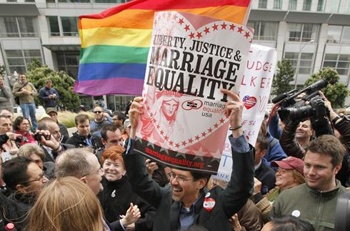
Same sex marriage and the 14th Amendment Cont’d
Notes:
After the 14th amendment was passed, same sex partners were very happy and for the first time many of them came to public and gave their opinions. All same sex partners felt recognized in all the 50 states.

Slide 12
Sociological Theory
Theory of Power – Based on this theory power rests at the top i.e. presidents, police, Supreme Court. They have all the authority, the resources, and influence.
The concept of the “pillars of support” where the general population’s willingness to accept the legitimacy of a regime and comply with their mandates – This is found both inside and outside of the government. The media, churches, educational system, the courts, and many more areas.
This is evident as presidents, courts, and churches/religions have pressed their opinions on what should or should not happen with laws regarding same sex marriage (Stepnisky, 2018).
Examples:
Supreme Court orders states to recognize same sex marriage
Religious Views stating that same sex marriage is a sin and that marriage is between a man and woman
President Obama endorsed same sex marriage in 2012
Notes:
According to the theory of power, those at the top usually have the authority and resources to influence most of the decisions. The theory of power supports the different court rulings that have ever been made about same sex marriage. Additionally, it is also this theory where the presidents opinion on same sex marriages gains a lot of influence (Stepnisky, 2018).

Slide 13
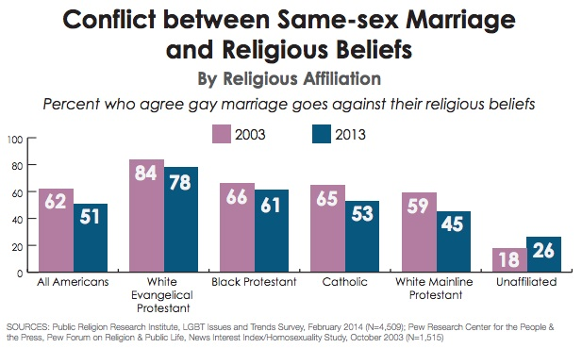
Questions
"I heard 75 percent of people are against gay marriage. Who are they?"
Notes:
These are the white evangelicals. They are the ones who believe that gay marriage is wrong
The number of white evangelicals who are against same sex marriage has been high over the years but the number is slowly dropping as more people are embracing same sex marriage. In this question, the people who are against same sex marriage and are about 75% of their total number are the white evangelicals who believe that same sex marriage is wrong.
"The 2016 survey found 75 percent of white evangelicals saying homosexual sexual relations are always or nearly always wrong. That number is down from 82 percent in 1996 and 90 percent in 1987."(Pulliam Bailey, 2017)

Slide 14
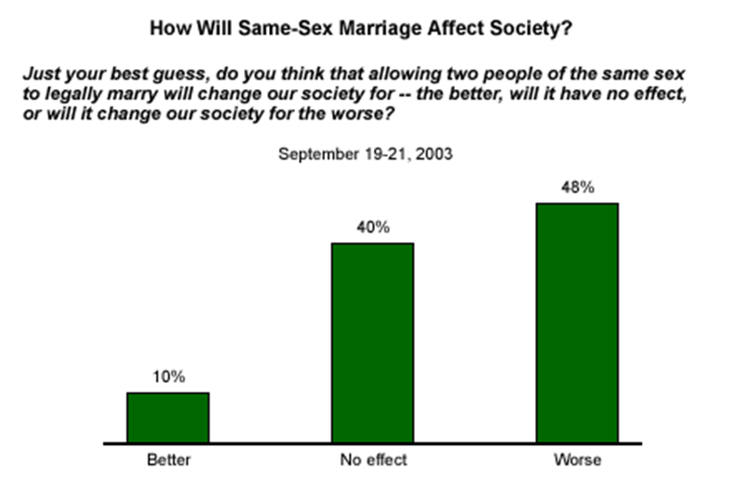
Questions Cont’d
"If we allow gays to marry, won't it destroy our social fabric?"
Notes:
Gay marriage is a wide known divisive topic in the United. States. Acorrding to Gallup data, “most Americans opposed (61%) to giving legal recognition to same-sex marriages, while 35% are in favor of doing so (Kiefer,2003).” Furthermore, Gallup polling also showed a noticeable monitory of 40% that believed same-sex marriages would not have mush effect on the United Sates society.

Slide 15
References
Pulliam Bailey, S. (2017). Poll shows a dramatic generational divide in white evangelical attitudes on gay marriage. Retrieved from https://www.washingtonpost.com/news/acts-of-faith/wp/2017/06/27/there-is-now-a-dramatic-generational-divide-over-white-evangelical-attitudes-on-gay-marriage/?utm_term=.bee788040973
Kiefer H. (2003, November). How Would Same-Sex Marriages Affect Society? Retrieved from https://news.gallup.com/poll/9670/how-would-samesex-marriages-affect-society.aspx
Prince, S.J. (2015 June 26) Retrieved March 13, 2018 from https://heavy.com/news/2015/06/scotus-gay-marriage-ruling-legalized-legalization-14th-amendment-history-facts-lgbt-rights-nyc-new-york-pride-weekend

Slide 16
References Cont’d
CNN Website LBGT Rights Milestones Fast Facts Retrieved March 13, 2019 from: https://www.cnn.com/2015/06/19/us/lgbt-rights-milestones-fast-facts/index.html
Georgetown Law Library(2018 February 20) A brief history of civil rights in the United States. Retrieved March 14, 2018 from: http://guides.ll.georgetown.edu/c.php?g=592919&p=418220
Poggione, S. (2019). The Evolution of Same-Sex Marriage Policy in the United States. In Oxford Research Encyclopedia of Politics.
Gerstmann, E. (2017). Same-sex Marriage and the Constitution. Cambridge University Press.
Stepnisky, J. (2018). Types of Sociological Theory. Core Concepts in Sociology, 295.

